Slide 1
Alomakoth
User Manual
Nathan & Sarah
Disclaimer: Final Release done so far is release 2.4. That release should be marked

Slide 2
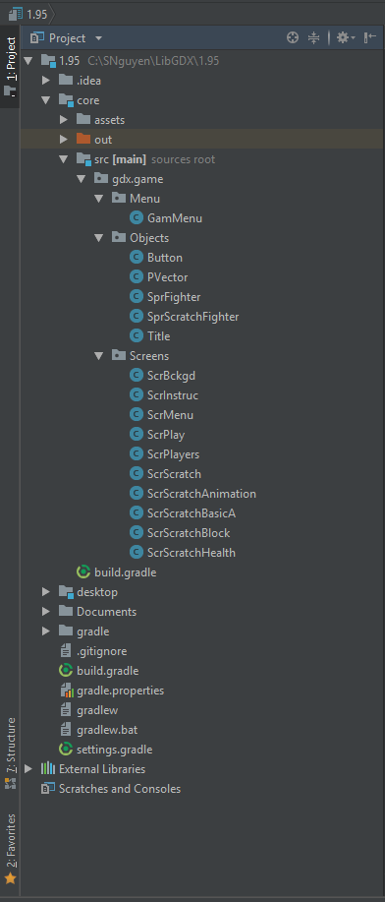
2. All documents are in the document folder highlighted in red
Within documents should be the “USER MANUAL” copy and “A- Final Package” which contains all the other paperwork.
The game and main code components is in release 2.4:
Open Core
Open src
Open gdx.game
Open Menu, Objects and Screens which is where all the code is located.
Menu: Has the extended Game
Objects has frequent objects used
Screens has all the screens we switch to in the game
Disclaimer: Screen might not look the same as screen shot

Slide 3
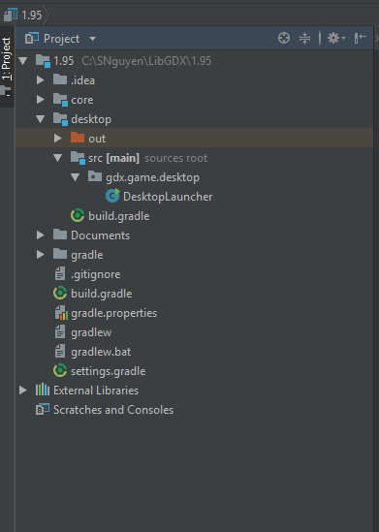
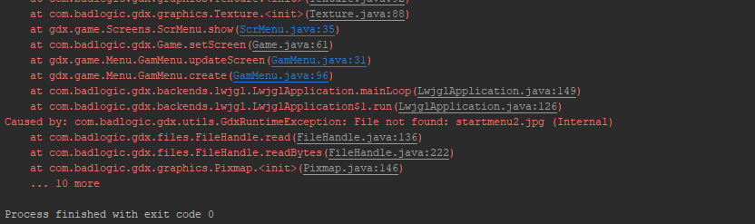
To actually run the program please assure the program is set to desktop launcher
Open the desktop folder
Open the scr folder
Open the gdx.game.desktop folder
Double click on DesktopLauncher. Then, in the very top toolbar click “run” then “run” again.
The program will crash. Let it crash.

Slide 4
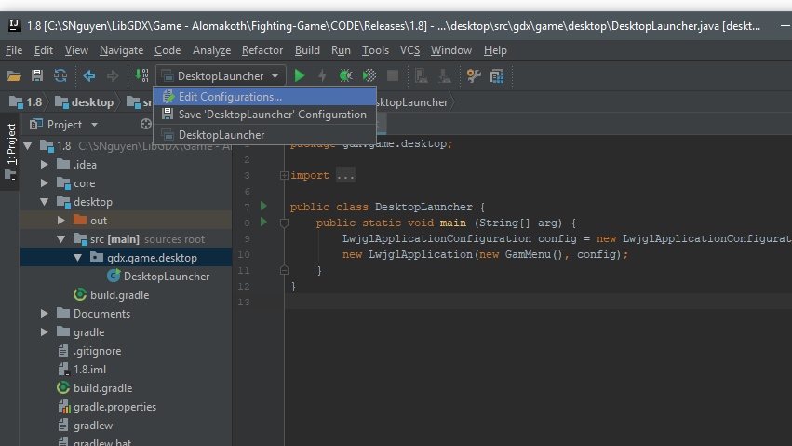
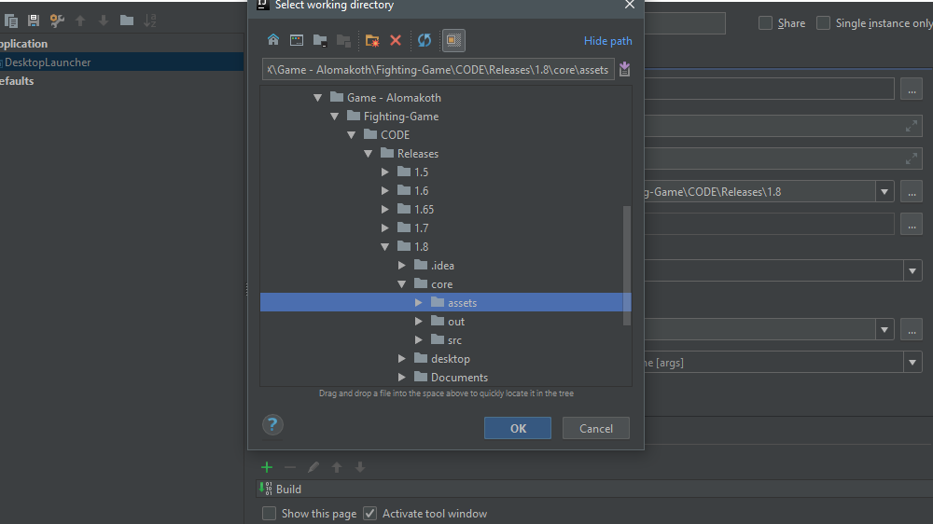
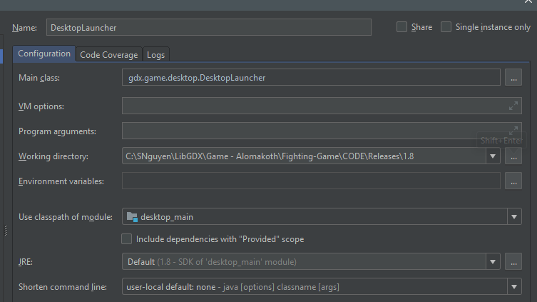
Click the arrow on “Desktop launcher” and select edit configurations
In the working directory section, make the program select the assets folder of the project. And click apply.
Run the program again to assure it works.

Slide 5
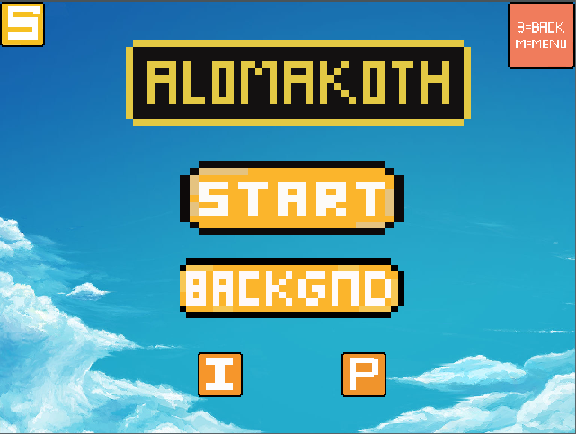
This is the main start menu of Alomakoth

Slide 6
To find scratches click the “S”.
At anytime, to go back one screen click “b” on your keyboard. Or, to go back to menu click the “m” key on your keyboard
To start the game click “start”

Slide 7
To look at the background of the game in more detail. Click the background button
To look at the instructions. Click the “I” button.
To look at the players in more detail. Click the “P” button.

Slide 8
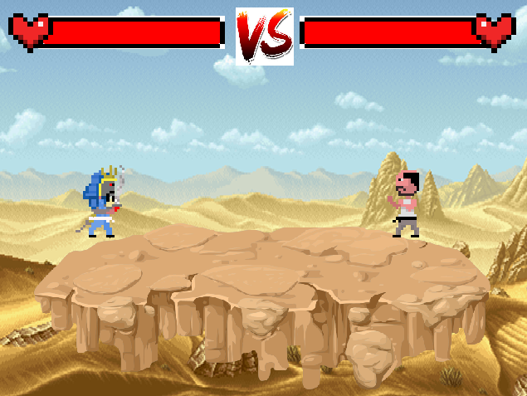
This is the game if you clicked the start button
Samurai Character:
A & D to move left and right
S to block
W to Jump
Space bar to attack
Black Belt Character:
LEFT & RIGHT directional keys to move left and right
UP directional key to jump
DOWN directional key to block
Enter key to attack

Slide 9
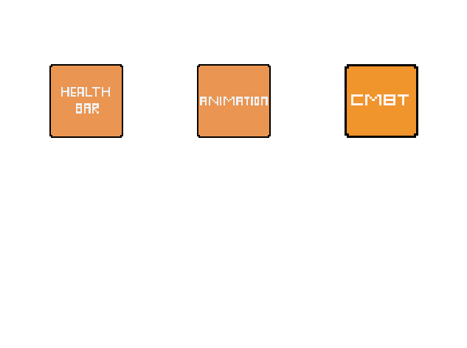
This is the game if you clicked the scratch button
Combat scratch
Health Bar Scratch
Animation Scratch

Slide 10
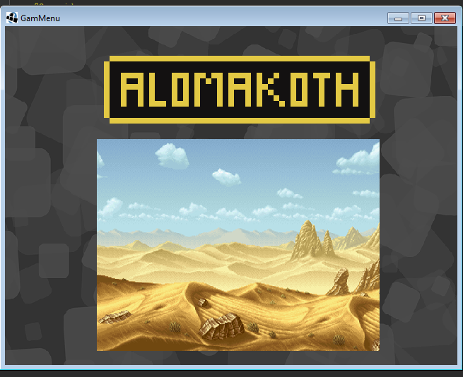
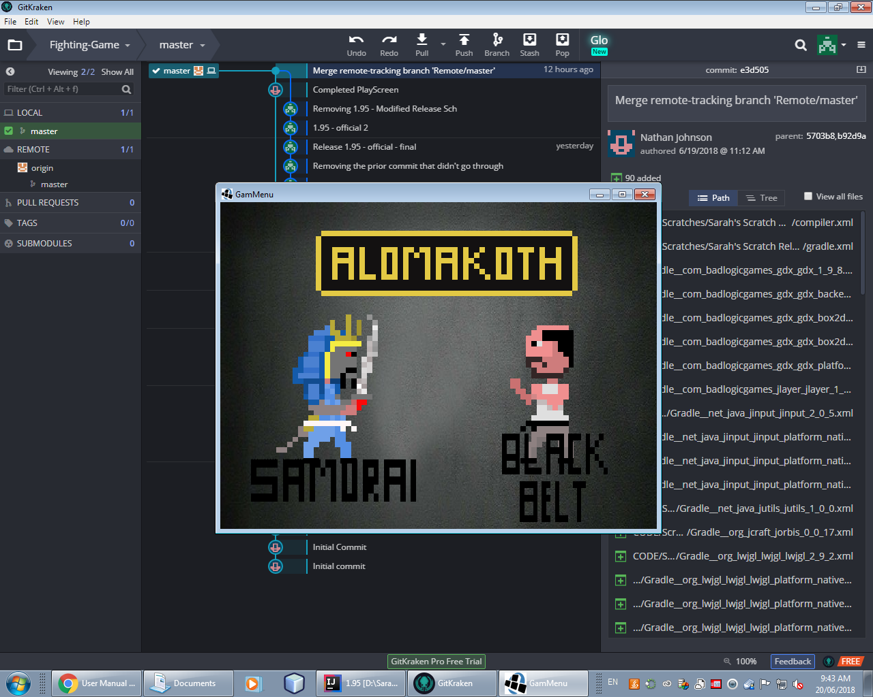
This is the screen if you clicked the “p” button for players
This is the screen if you clicked the “backgnd” button.

Slide 11
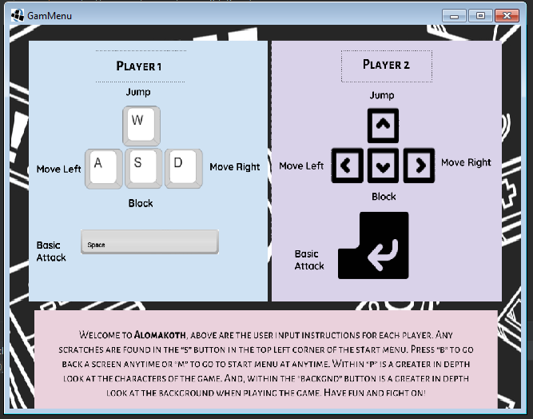
This is the game if you clicked “i” button for instructions
The user input for player one
The user input for player two
Intro to the game

